Slide 1

ALL ABOUT CHESS
By :
JAGADEESWARAN.S

Slide 2
Details:
Student Name : JAGADEESWARAN.S
Register No :24BCS021
NMID : 757682DA89E04BA82DD48C10B272D904
Department : BSc Computer Science
College : Government Arts College (Autonomous),
Coimbatore.

Slide 3



Problem statement:
Many beginners struggle to understand the rules, moves, and strategies of chess. This project aims to provide an easy-to-understand, beginner-friendly webpage to make learning chess more accessible.

Slide 4

Project Overview:
“All About Chess” is a static informative webpage designed to explain the basics of chess, including:
History and introduction of chess
Basic rules and movements
Benefits of playing chess

Slide 5


End Users:
Students and beginners learning chess
Chess enthusiasts exploring basic concepts
Educational platforms using it as a learning aid

Slide 6
Tools and Technologies:
HTML5 – Structure of the webpage
CSS3 – Styling and layout design
Responsive Web Design – Mobile and desktop compatibility
GitHub – Version control and project hosting

Slide 7
Portfolio Design and Layout:
Clean and minimal design
Dark header for contrast
Card-style sections for content clarity
Footer with external resource link for deeper learning

Slide 8
Features and Functionality:
Introduction Section: Explains chess and its history
Rules Section: Basic rules and movements of pieces
Benefits Section: Why chess is good for mental growth
External Links: Redirects to learning resources like Chess.com

Slide 9
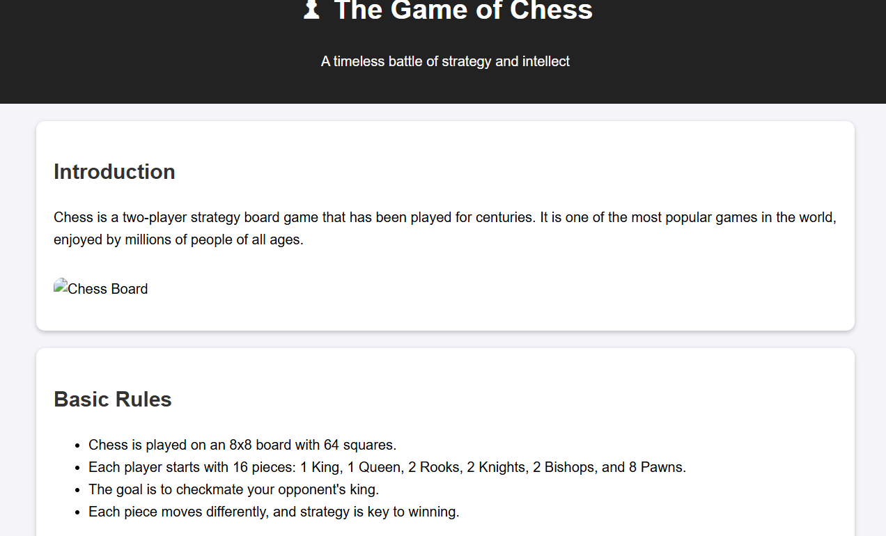
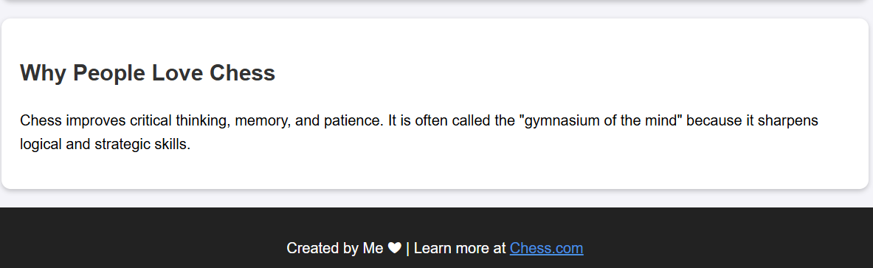
Results & Screenshots:
Successfully built a functional, responsive webpage
Clean interface and smooth user experience

Slide 10
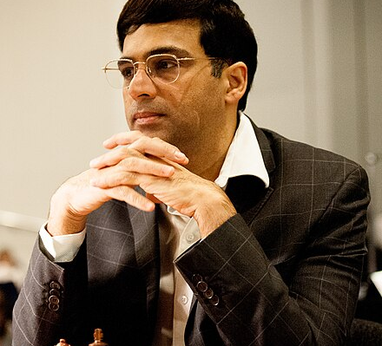


Conclusion:
The project demonstrates basic web development skills while providing a useful educational resource for anyone interested in learning chess.

Slide 11

Thank You
GitHub Repository: https://github.com/jagancse2006-glitch/chess

